Slide 1
529 Advance Data Analytics Midterm Project
October 18, 2016
Group Members
Simrat Sidhu – A20344637
Dhruv Sethi – A20344822

Slide 2
Table of Contents
Business Scenario
Business Objective & Questions
Source Overview
Data Set Overview
Identify Variables
Exploratory Data Analysis Results
Regression Results
Conclusion

Slide 3
Business Scenario
As heart diseases and heart attacks are gradually increasing over the years especially in US, Doctors in hospital want to accurately predict chances of heart related problems for their patience. So the Health Surveillance branch is given the task to collect uniform health specific data for all the states in the US, so we decided to build a model using data set from year 2013 to help doctor’s predict future heart related problems for their patient’s accurately. Doctor’s in a hospital want to increase the accuracy of predicting risk of heart attacks for patience to their customers. They need models that would help them in doing so. In this we use the data provided by BRFSS for the year 2013 to build these models.

Slide 4
Business Objective & Questions
The objective of this study is to predict the risk of heart attack accurately. This will be addressed by building an equation to identify the chances of heart attack in patients. The equation will be take into consideration health practices, gender and age of the patients
Question1 – By how many times high BP and smoke increase the chances of having a heart attack ?
Question2 – Is heart attack more common in Male then in Female ?
Question3 – Do White people have more chances of heart attack than other races ?

Slide 5
Source Overview
The data used in analysis was collected by Behavioral Risk Factor Surveillance System (BRFSS) as an annual survey.
The BRFSS is a collaborative project between all of the states in the United States and participating US territories
The data contains the information about risk behaviors that are linked to chronic diseases and preventive infectious diseases that affect the adult population for year 2013.
Factors that are assessed by the BRFSS in 2013 include tobacco use,
inadequate sleep, cholesterol awareness, hypertension, care access,
heart attack occurrence etc.

Slide 6
Data Set Overview
File Name – health_brfss_20.sasb7dat
Source of Data - http://www.cdc.gov/brfss/annual_data/annual_data.htm
Total Number of observations -1194200
Total number of variables - 330
Total number of variables used in our analysis - 7
All the variables in our data set are categorical.
Some of the variable used in analysis are modified to convert them into binary values.

Slide 7
List of Variables
The table below shows the list of variables
Sr No. | Variable | Type | Description | Range
1 | BPHIGH | Categorical | High Blood Pressure | 1-4
2 | CVDINF | Categorical | Heart Attack | 1-2
3 | CVDCRH | Categorical | Cholesterol | 1-2
4 | X_SMOK | Categorical | Smoke | 1-4
5 | SEX | Categorical | Gender | 1-2
6 | X_IMPR | Categorical | Ethnicity | 1-6
7 | SLEEPTI | Categorical | Average Sleep Hours | 1-24

Slide 8
List of Calculated Variables
Variables BP, SLEPTI, X_IMPR & X_SMOK have more than 2 categories. Therefore these 4 variables are transformed into binary variables for th simplicity of analysis
Variable Name | Values | Computed Variable | Values
BPHIGH (Blood Pressure) | 1- Yes, 2-Yes, but female told during pregnancy, 3-No, 4-Borderline | BP | 1- Yes and all other values are assumed as NO i.e. 2.
SLEEPTI (Sleep Time) | 1-24 (hrs) | SLEEP | 1 - Range:1 to 5 2 – Range: 5 to 9 3 – Range: 10 to 24
X_IMPR (Ethnicity) | 1- White, 2-Black, 3-Asian, 4-American, 5-Hispanic, 6-Other | ETHIN | 1- White and all other races are grouped under 2.
X_SMOK (Smoke) | 1-Smoke Everyday, Smoke Someday, 3- Former, 4- Never Smoked | SMOKE | 1,2 and 3 are grouped under 1 and 4 is mapped as 2.

Slide 9
Identify Response Variable & Predictor Variable
Response Variable (Y) - CVDINF is the response/dependent variable.
Y = 1 Indicates Yes, a person is diagnosed with a heart attack
Y = 2 Indicates No, a person is not diagnosed with a heart attack
Predictor Variables (X) – BP, SEX, SLEEP, ETHNI & SMOKE are the predictor variables used in the analysis

Slide 10
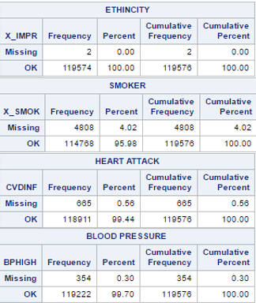
Exploratory Data Analysis – Missing Values
Since no analysis is performed on data values such as Don’t Know/Not Sure, Refused, N/A therefore, they are assumed to be missing values.
The missing values for the variables chosen range from 0 to 4.02%. Since the missing values are almost negligible, therefore records with missing values are excluded from the analysis.

Slide 11
Exploratory Data Analysis - Association
Association – Categorical Variables:
The relation of Response variable with the possible predictor variables. Statistical techniques such as frequency tables gives us p-value and chi-square to determine if the Response variable has any association with the predictor variables.
The list of all the predictor variables is on slide 9
The next few slides have tables indicating p-value and chi-square for each of the predictor variable

Slide 12
Exploratory Data Analysis - Association
When the p-value < 0.05, then there is enough evidence at the 0.05 significance level to reject the null hypothesis of relationship i.e. we can conclude that the relationship exist between the variables. Since for all variables P<.0001 the Null Hypothesis is rejected
Variable | P-Value
ETHIN | P<.0001 – So Null hypothesis is rejected
SMOKE | P<.0001 - So Null hypothesis is rejected
BP | P<.0001 - So Null hypothesis is rejected
SEX | P<.0001- So Null hypothesis is rejected
X_RFBM (weight) | P<.0001 - So Null hypothesis is rejected
SLEEP | P<.0001 - So Null hypothesis is rejected

Slide 13
Exploratory Data Analysis - Association
The chi-square of the below predictor variables is high providing evidence that these variables have association with the response variable.
Thus the variables below can be used in our models
We have also mentioned Cramer’s V associated with each variable which gives the strength of the association with the variables. Looking at Cramer’s v we can say that the strength of the association of Heart Attack is strongest with BP and weakest with SMOKE.
Variable | Chi-Square | Cramer’s V
ETHIN | 99.41 | 0.028
SMOKE | 65.51 | 0.024
BP | 3736.07 | 0.177
SEX | 597.72 | 0.07
SLEEP | 579.99 | 0.08

Slide 14
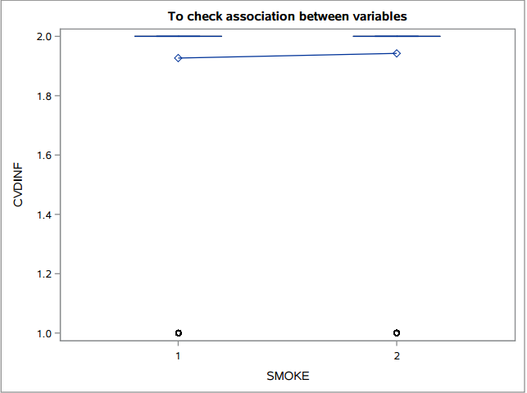
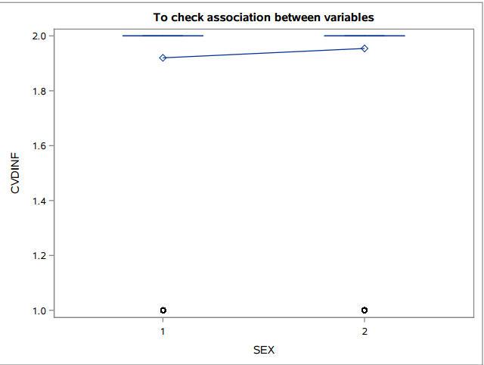
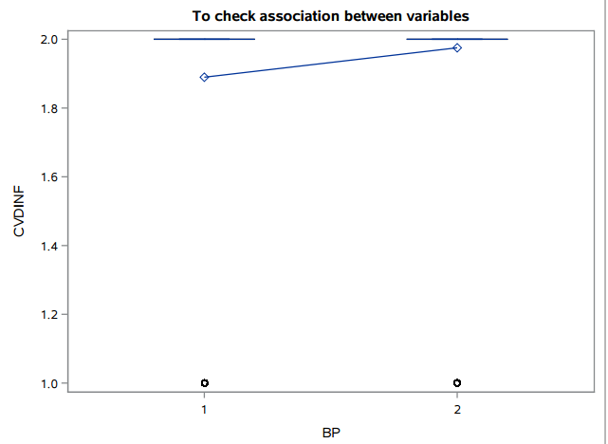
Exploratory Data Analysis - Association
These plots further indicate that the association between the variables exist

Slide 15
Regression Modeling Results – Building the Model
For this analysis, Binary Regression model is used. Binary Regression Model, is used to build a regression model when the response variable is binary such as in our case.
After exploring the data by identifying the best predictor variable and finding out the appropriate regression modeling technique. Next step is to build the model.
We use the Proc Logistic Function to build the model in SAS.
In building this model we use Event = ‘Yes’, which calculates he probability of having a heart attack

Slide 16



Regression Modeling Results - Analyzing the chances of Heart Attack in Male vs Female
Odds ratio – e(0.5942) = 1.812 – This means male have 2 (1.812) times more risk of having a heart attack than females.
95% of the data lies between 1.726 and 1.901
Also the c value is greater than 0.5 which implies that the model is accurate
Since in males chances of heart attack is 2 times more than females therefore it can be concluded that heart attack is more common in males than females.

Slide 17
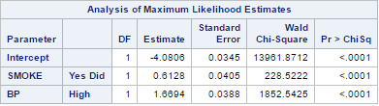


Regression Modeling Results – Analyzing our Second Model
In this model the chances of heart attack for the smokers who have high BP is analysed.
Comparison of smoke indicates that people who smoke have 1.8 times higher chances of having heart attack
In this model the c value is 0.717 which also indicates that the model is accurate since the value is greater than 0.5.
The smokers who have high BP have 5 times the odds of getting heart attack than non somkers. Thus, it can be conclude that person who smokes and have high BP have 5 times more chances of getting heart attack than person who does not smoke and hav low BP.

Slide 18



Regression Modeling Results – Analyzing our Third Model
In this we have compared probability of having heart attack in whites or other races
Odds ratio here is e(0.2879) = 1.334 which indicates that odds of heart attack in white people is 1.3 times more than other races.
The c value is greater than 0.5 which implies that the model is accurate.
On the basis of analysis, it can be concluded that, yes the white people have more than chances of heart attack than other races by 1.3 times.

Slide 19
Conclusion
The first model indicates that Male have 2 times more chance of having heart attack then females., thus making heart attack more common in males than females.
The second model which indicates person who smokes and have high BP have 5 times more chances of getting heart attack than person who does not smoke and hav low BP.
Second model is the most accurate model as the c value for this model is 0.717 which is the highest.
The third model indicates that whites have 1.3 times more chances of having heart attack than other race.
Third model is the least accurate model as the c value is the lowest among other models i.e 0.527. Also, the value for Cramer’s V i.e. 0.028 indicated that strength of association of Ethnicity with Heart Attack is very weak as the value is closer to 0.

